Slide 1


Sustainability Food Ordering System
GreenOrder
Carbon-Smart
Food Ordering System
Team 6 LosAmigosIT
Notes:
Good Morning everyone!
Today, our team6 LosAmigoIT, is going to introduce the product we developped to u.
GreenOrder
It is a carbon smart food ordering system
Before started, please let me introduce who we are.

Slide 2




Team Member
Wei Yiyi
Amjad Kamel
David Blezinger
Naim Yachou
Project Manager
Product Manager
UX Designer
Software Developer
Sustainability Food Ordering System
Notes:
First, let me introduce our team.
We have Yiyi, our Project Manager, and David, who is responsible for our user experience and interface design.
I’m [Your Name], the software developer on the team.
Unfortunately, our Product Manager, Amjad, couldn’t be here today due to travel commitments, but he’s shared his insights with us.
Now, we’re readuy to show y”all what we”ve been working on!

Slide 3

Team 6 LosAmigosIT
Agenda
01 System Introduction
02 Function Details
03 Demo Showcase
Notes:
After a really quick overview of today. lets go for the first section.

Slide 4
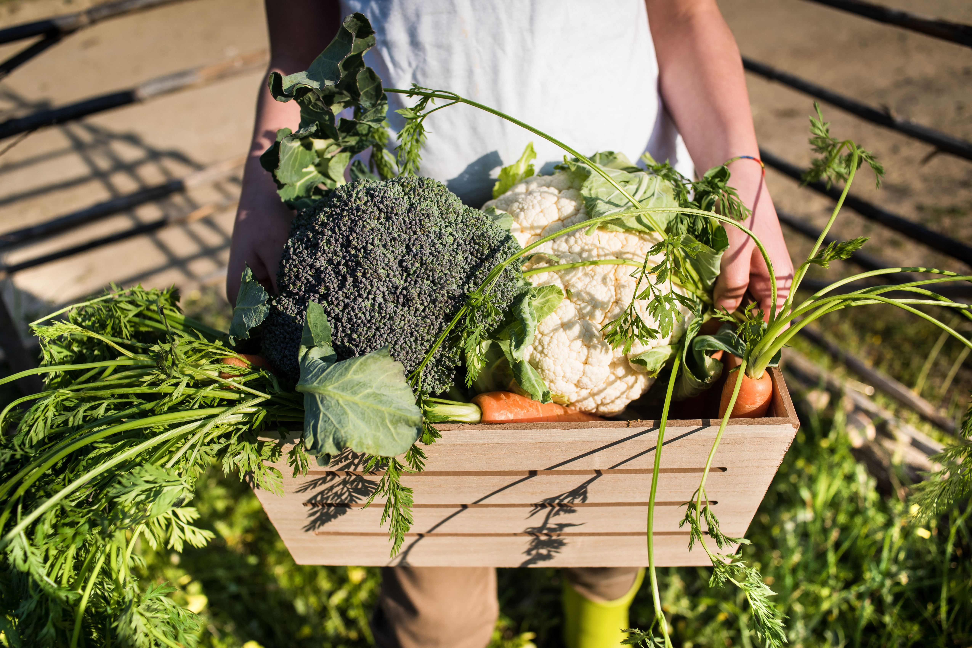
01/
System Introduction
-- GreenOrder
Notes:
Our System is GreenOrder.You would be confused about this name.

Slide 5

What is GreenOrder?
A Carbon-Smart Food Ordering System that
offers optimal sustainable transport alternatives
Why do we need GreenOrder?
“food miles” emissions are higher than previously thought
---from Research
To decide for the best food sourcing option based on comparing CO2 emissions, price and quality
Notes:
and it utilizes advanced algorithms model and real-time data to recommend sustainable transportaion choices.
From newest reaserach , we know that Global “food miles” emissions are higher than previously thought – accounting for nearly one-fifth of total food-system emissions.
So now, A system that provides consumers with effective and sustainable food mile is important.
So, what do we do here?
Our system, GreenOrder, provides users with eco-friendly alternatives that not only benefit the planet but also promote customer efficentcy.
Additionally, the platform collaborates with suppliers to ensure that the food is both fresh and sustainably sourced, fostering a community of conscious consumers dedicated to making a positive impact on the environment.
Let me show your more details

Slide 6


02/ Function Details
--- Providing a diverse array of food transportation options

Slide 7

Use Case:
Strategic Ordering for Sustainability in Large Supermarket Chains
Original Source
Supermarket Chain
Companies
in
different cities
Supermarkts
in
different cities
Which route should be selected?
Notes:
Imagine you want to order apples for your supermarket, and there are a lot of apple producers in the world, from different distances, and your company has follow the rules of sustainability, so which producer is the best choice for you?

Slide 8


GreenOrder
Source 1
Source 2
Source N
From Location 1
to the supermarket.
From Location 2
to the supermarket.
From Location N
to the supermarket.
...
Vehicle Type
Carbon Emission
Transport
Routes
Not enough?
Notes:
Our system provides you with a variety of detailed scenarios, with different routes corresponding to detailed sustainability data:Vehicle Type, Carbon Emission, Transport Routes
Still not enough? I know that only sustainable development is not enough for a company either!

Slide 9




GreenOrder
Price
Quality
CO2 Emission
Quality/Price Ratio
We provide detailed comparisons.
Notes:
We also want to provide you with data on a variety of food quality dimensions
to ensure that you avoid ordering bad fruit and avoiding food waste to the fullest extent possible!
Now let us show you the tech behind.

Slide 10
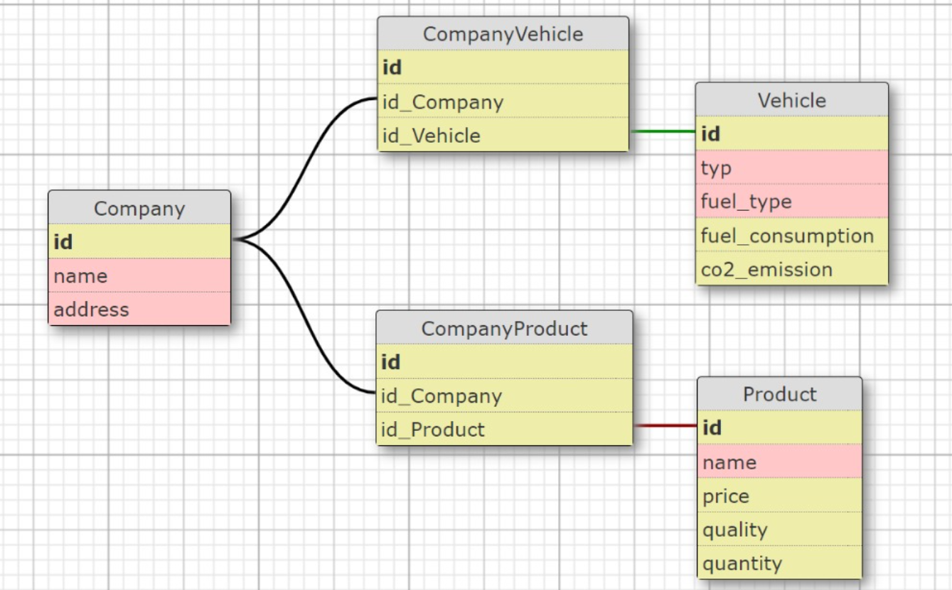

Tech Behind:
Own DataBase Overview
Notes:
First we constructed our own database with specific information about suppliers and shipping modes

Slide 11

Tech Behind:
Ouput
Dashboard
Map
CO2 Emission Function
Own DataBase
DataBase
Analysis
Quality-Price Ratio Function
Map Route API
Input
product name
destination
Notes:
And, then we combined the
real-time map api to build a completed database.
We provide two algorithms, one for CO2 emissions
and one for food quality detection
In the end, we visualised it using a dashboard and map.

Slide 12

03/
Demo Showcase
-- GreenOrder

Slide 13
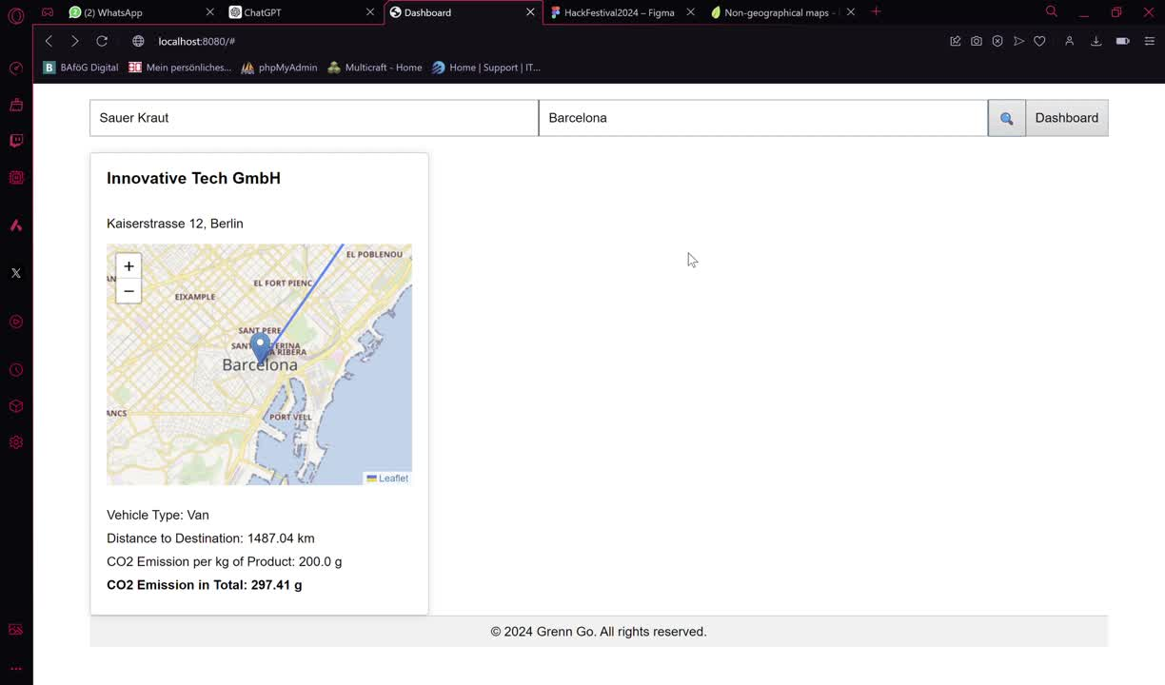
https://main-appreciative-parrot-kl.cfapps.us10-001.hana.ondemand.com

Slide 14
Sustainability Food Order System
Happy to Questions :)
Thanks !
GreenOrder
Team 6 LosAmigosIT

Slide 15
Team 6 LosAmigosIT
References
1.https://images.app.goo.gl/4htPMZKTEE6aAFDv6
2.https://akzente.giz.de/en/cop27-global-co2-emissions-greenhouse-gases
3.https://epub.wupperinst.org/frontdoor/deliver/index/docId/5716/file/5716_Wood.pdf

